Slide 1
Engaging with Young Professionals
Caroline Chan

Slide 2
Who am I?
History in IEEE:
Santa Clara EMC Chapter volunteer (Chair, Treasurer) since 2009
Social Chair Assistant in 2010 IEEE EMC
Symposium (Fort Lauderdale)
- EMC Young Professionals Representative since 2011
General Chair for IEEE Symposium on EMC and SI in 2015 (Santa Clara)
Elevated to Senior member in 2015
Member of the BoD and Chapter Coordinator 2016
Born in Africa, raised in a Chinese family, brought up in a French Education and finally got Americanized.
Multi-lingual: Cantonese, Mandarin, French, English and a little bit of Spanish

Slide 3
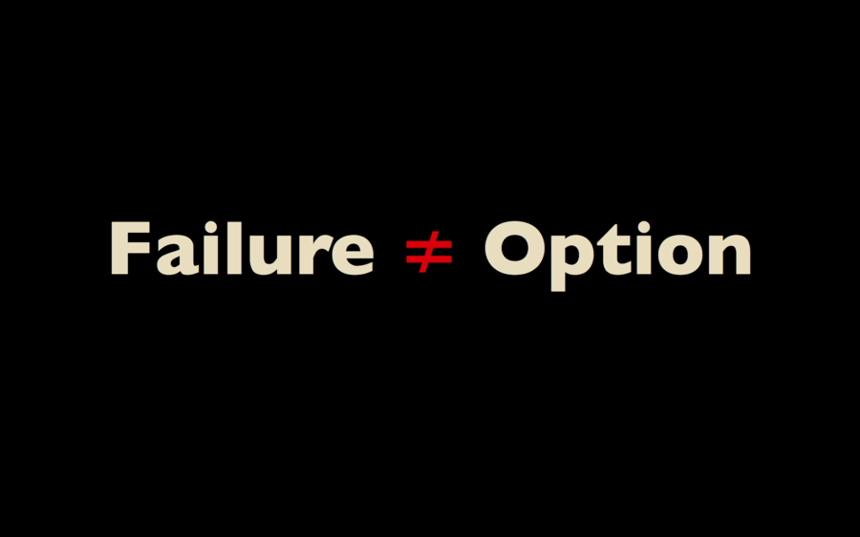
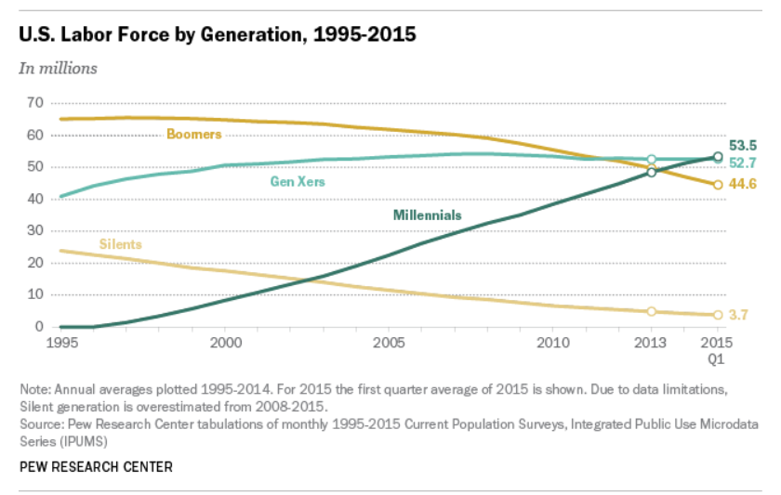

Slide 5
Who are the Young Professionals/Millenials?
Disloyal
Entitled
Want Privileges
Lazy
Need Constant Positive Reinforcement

Slide 6
1. Disloyal

Slide 7
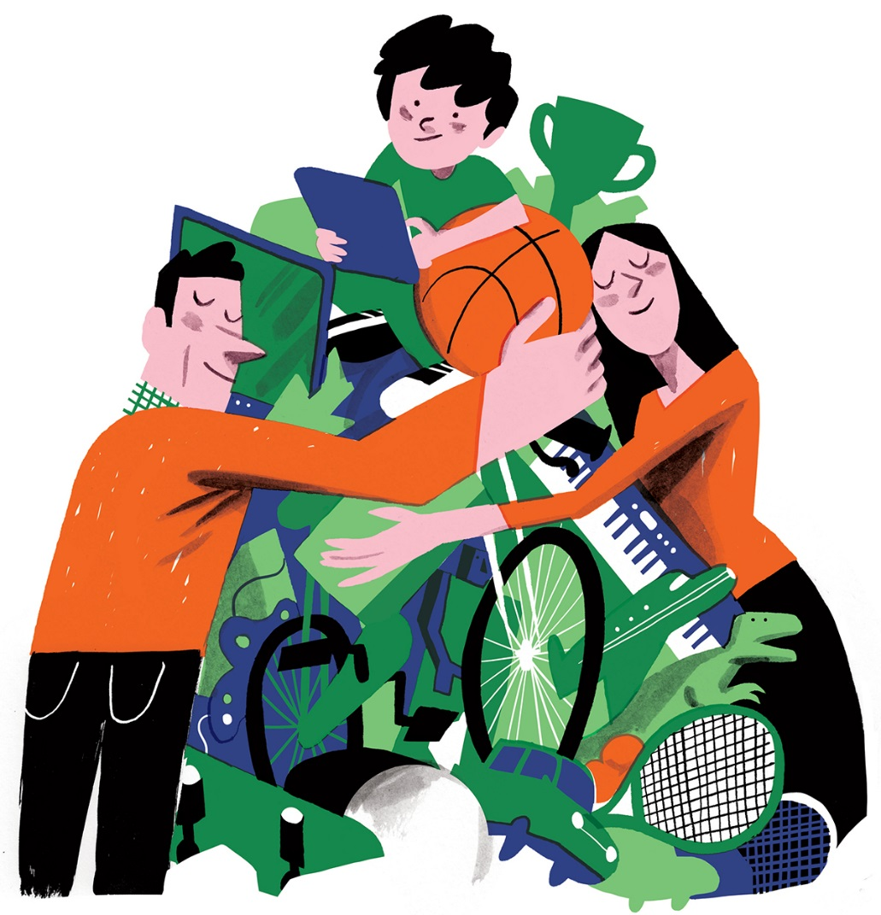
2. Entitled

Slide 8
3. Privileges

Slide 9
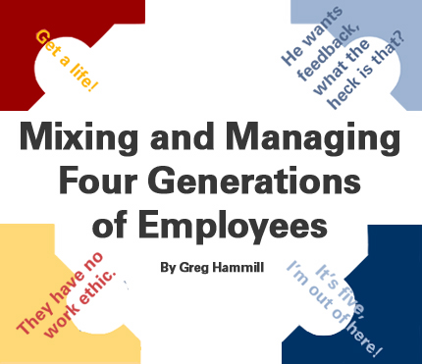
4. Lazy

Slide 10
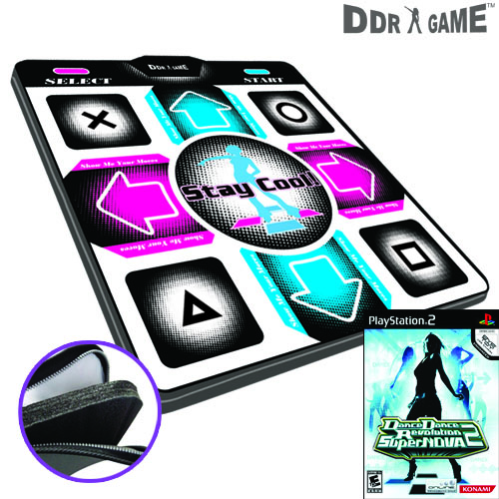
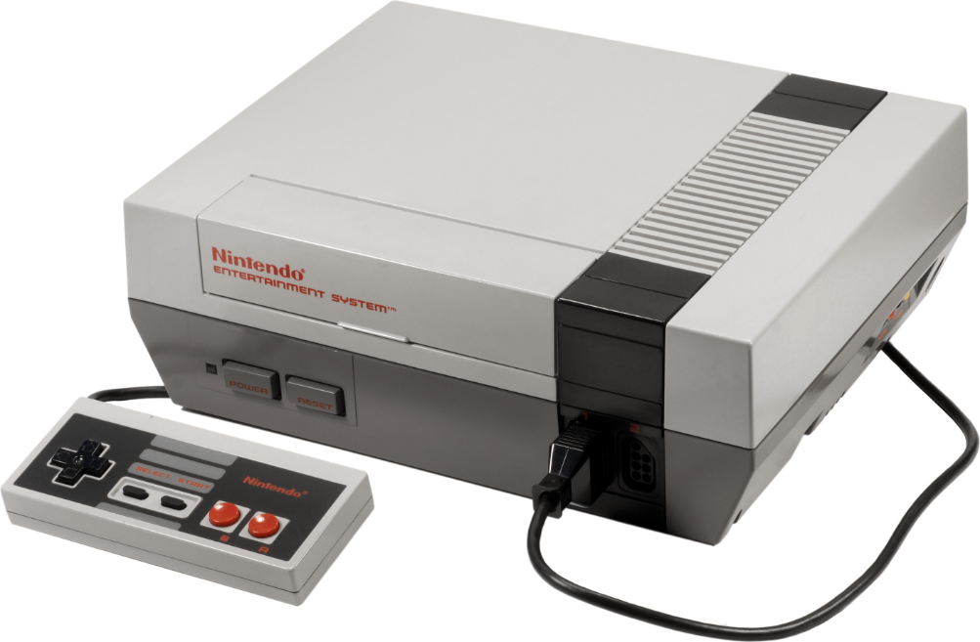
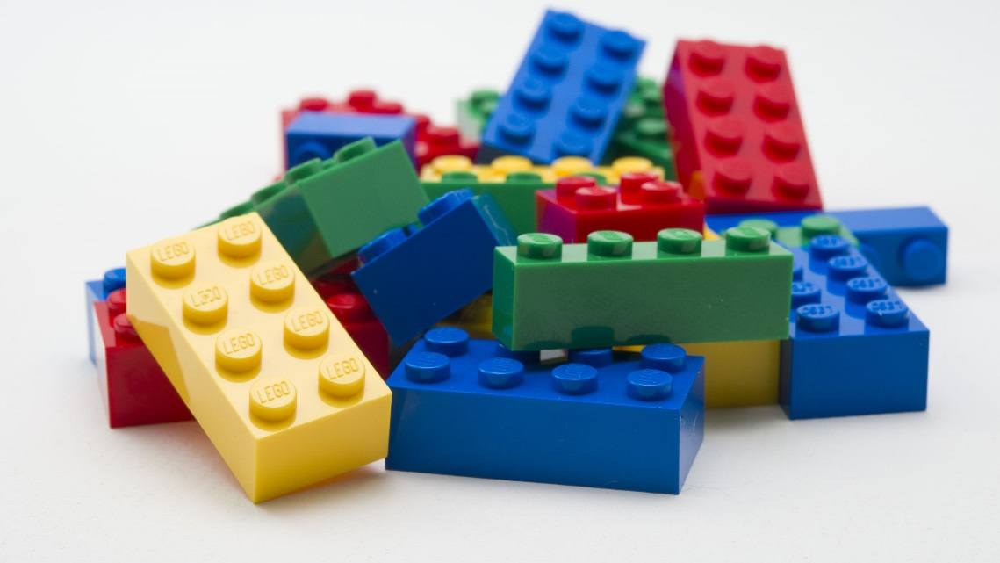
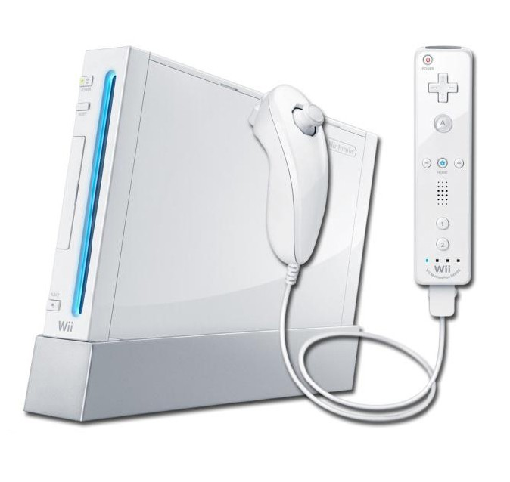
5. Need Constant Positive Reinforcement

Slide 11
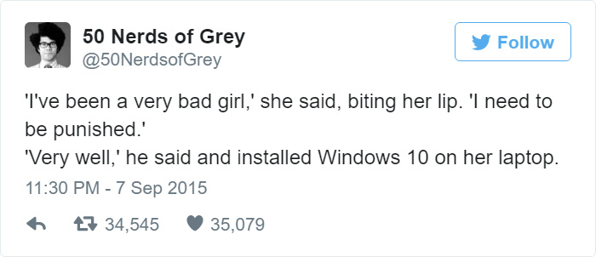
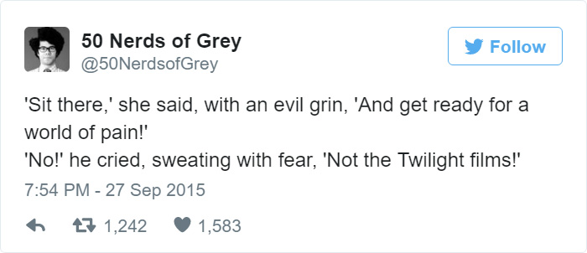
Understand their culture

Slide 12
No arbitrary rules, instead change your message delivery method – Share stories

Slide 13
Be International, Thank the volunteers

Slide 15
Leaders create Leaders
OR

Slide 16
Equip young professionals to think and act like leaders who take initiative.

Slide 17
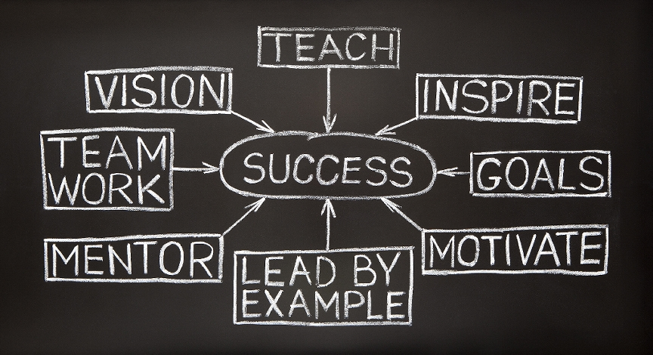

Slide 18
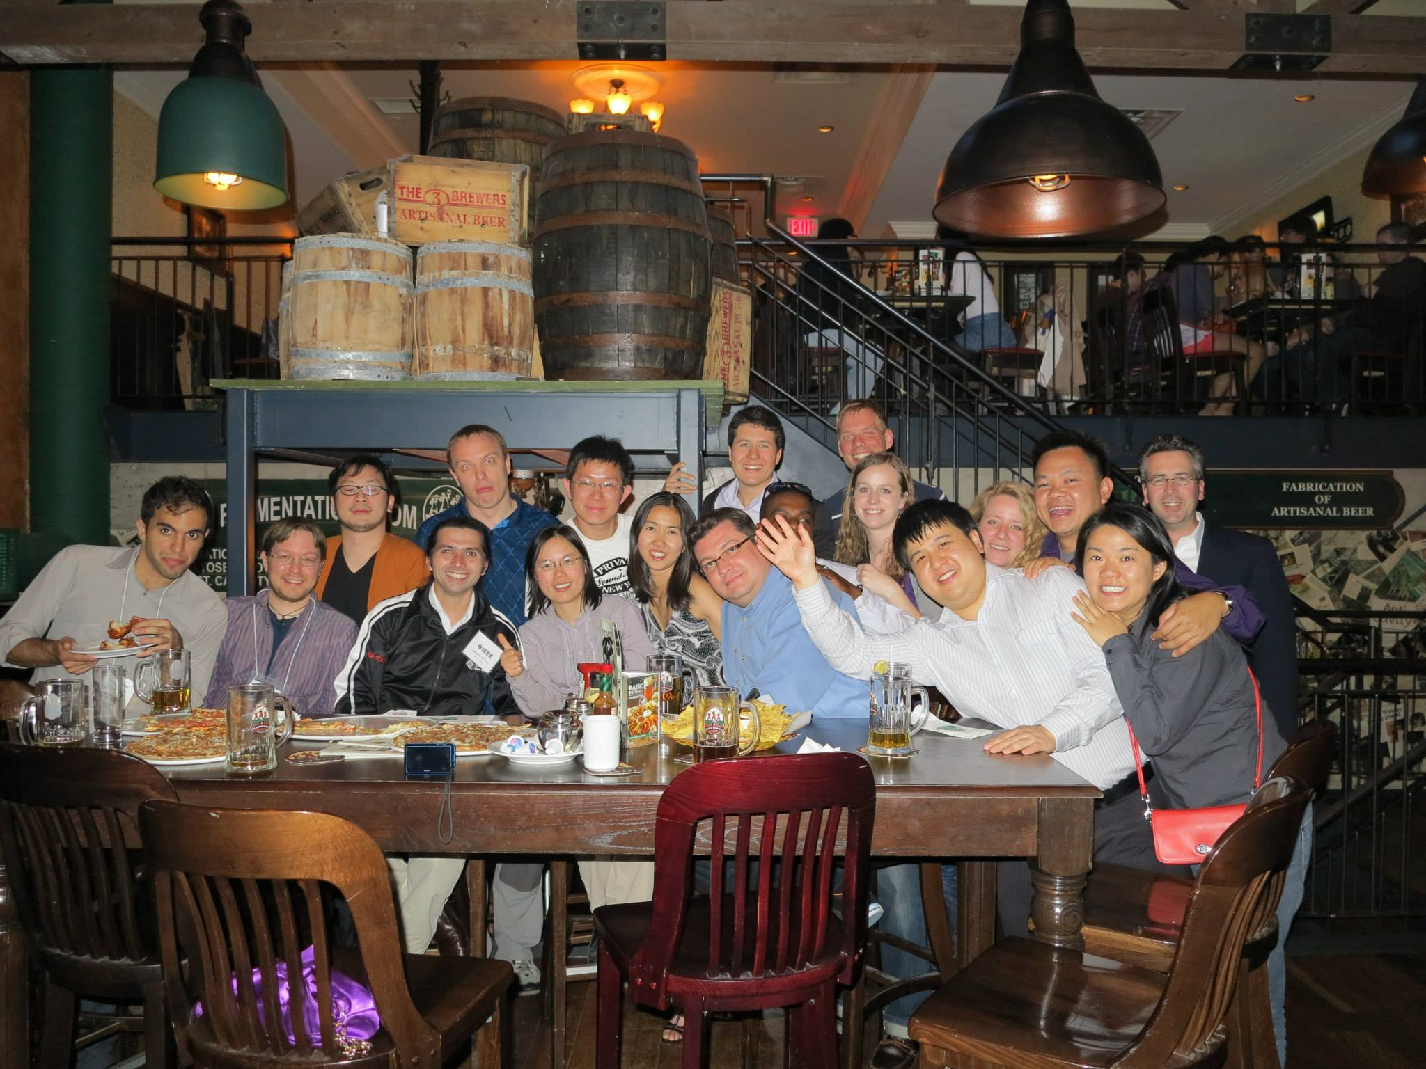
Have you checked out the YP affinity group in your Region?

Slide 19
Your turn
Ask 5 Young Professionals in this Symposium why they are/are not a member of the EMC Society and why they are/are not volunteering
Be aware that all Millennials have now graduated from College. It is now the Generation Z= iGeneration or Homeland Generation going to College

Slide 20
Young Professionals activities
Network Reception and Haunted Walk Monday July 25th, 2016
Luncheon Wed 12:00pm-1:30pm at Blue Cactus with Johanna Hill on “Take charge of your destiny”
IEEE EMC YP Representative 2017:
Al Frye a.frye.us@ieee.org

